Slide 1

Strategic Action Plan 1.0

Slide 2


How we got here Board of Directors requested development of strategic plan to guide resources and activity
Identified challenges facing utilities – defined specific shocks and stresses
Defined qualities of a resilient utility
Brainstormed goals and solutions
Organized solutions by goal areas
Established Progress Indicators
Identified Year of Implementation, Lead/Partners, and related Cost/Revenue
2 brainstorming sessions

Slide 3

Purpose & Guiding Principles
Serves as RUC’s guiding document for priority activities over the next 5-years.
Formalizes the partnership
Builds upon successes over the last two years.
Actions designed to strengthen not only utilities but the network of stakeholders:
industry professionals
academia and partner organizations
community and professional associations and organizations.
Serves as a shared “playbook” among stakeholders to advance shared resilience goals.
Includes the main tenants of a culture that bounces forward in the face of challenges – awareness, capacity, efficiencies, flexibility, innovation, and collaboration

Slide 4
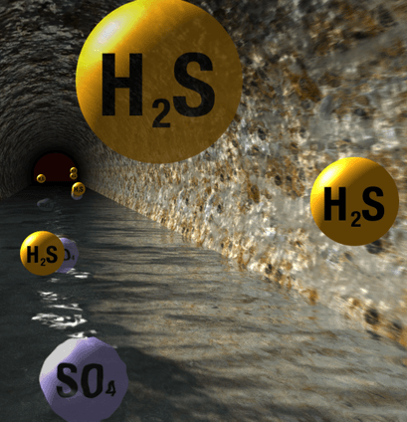
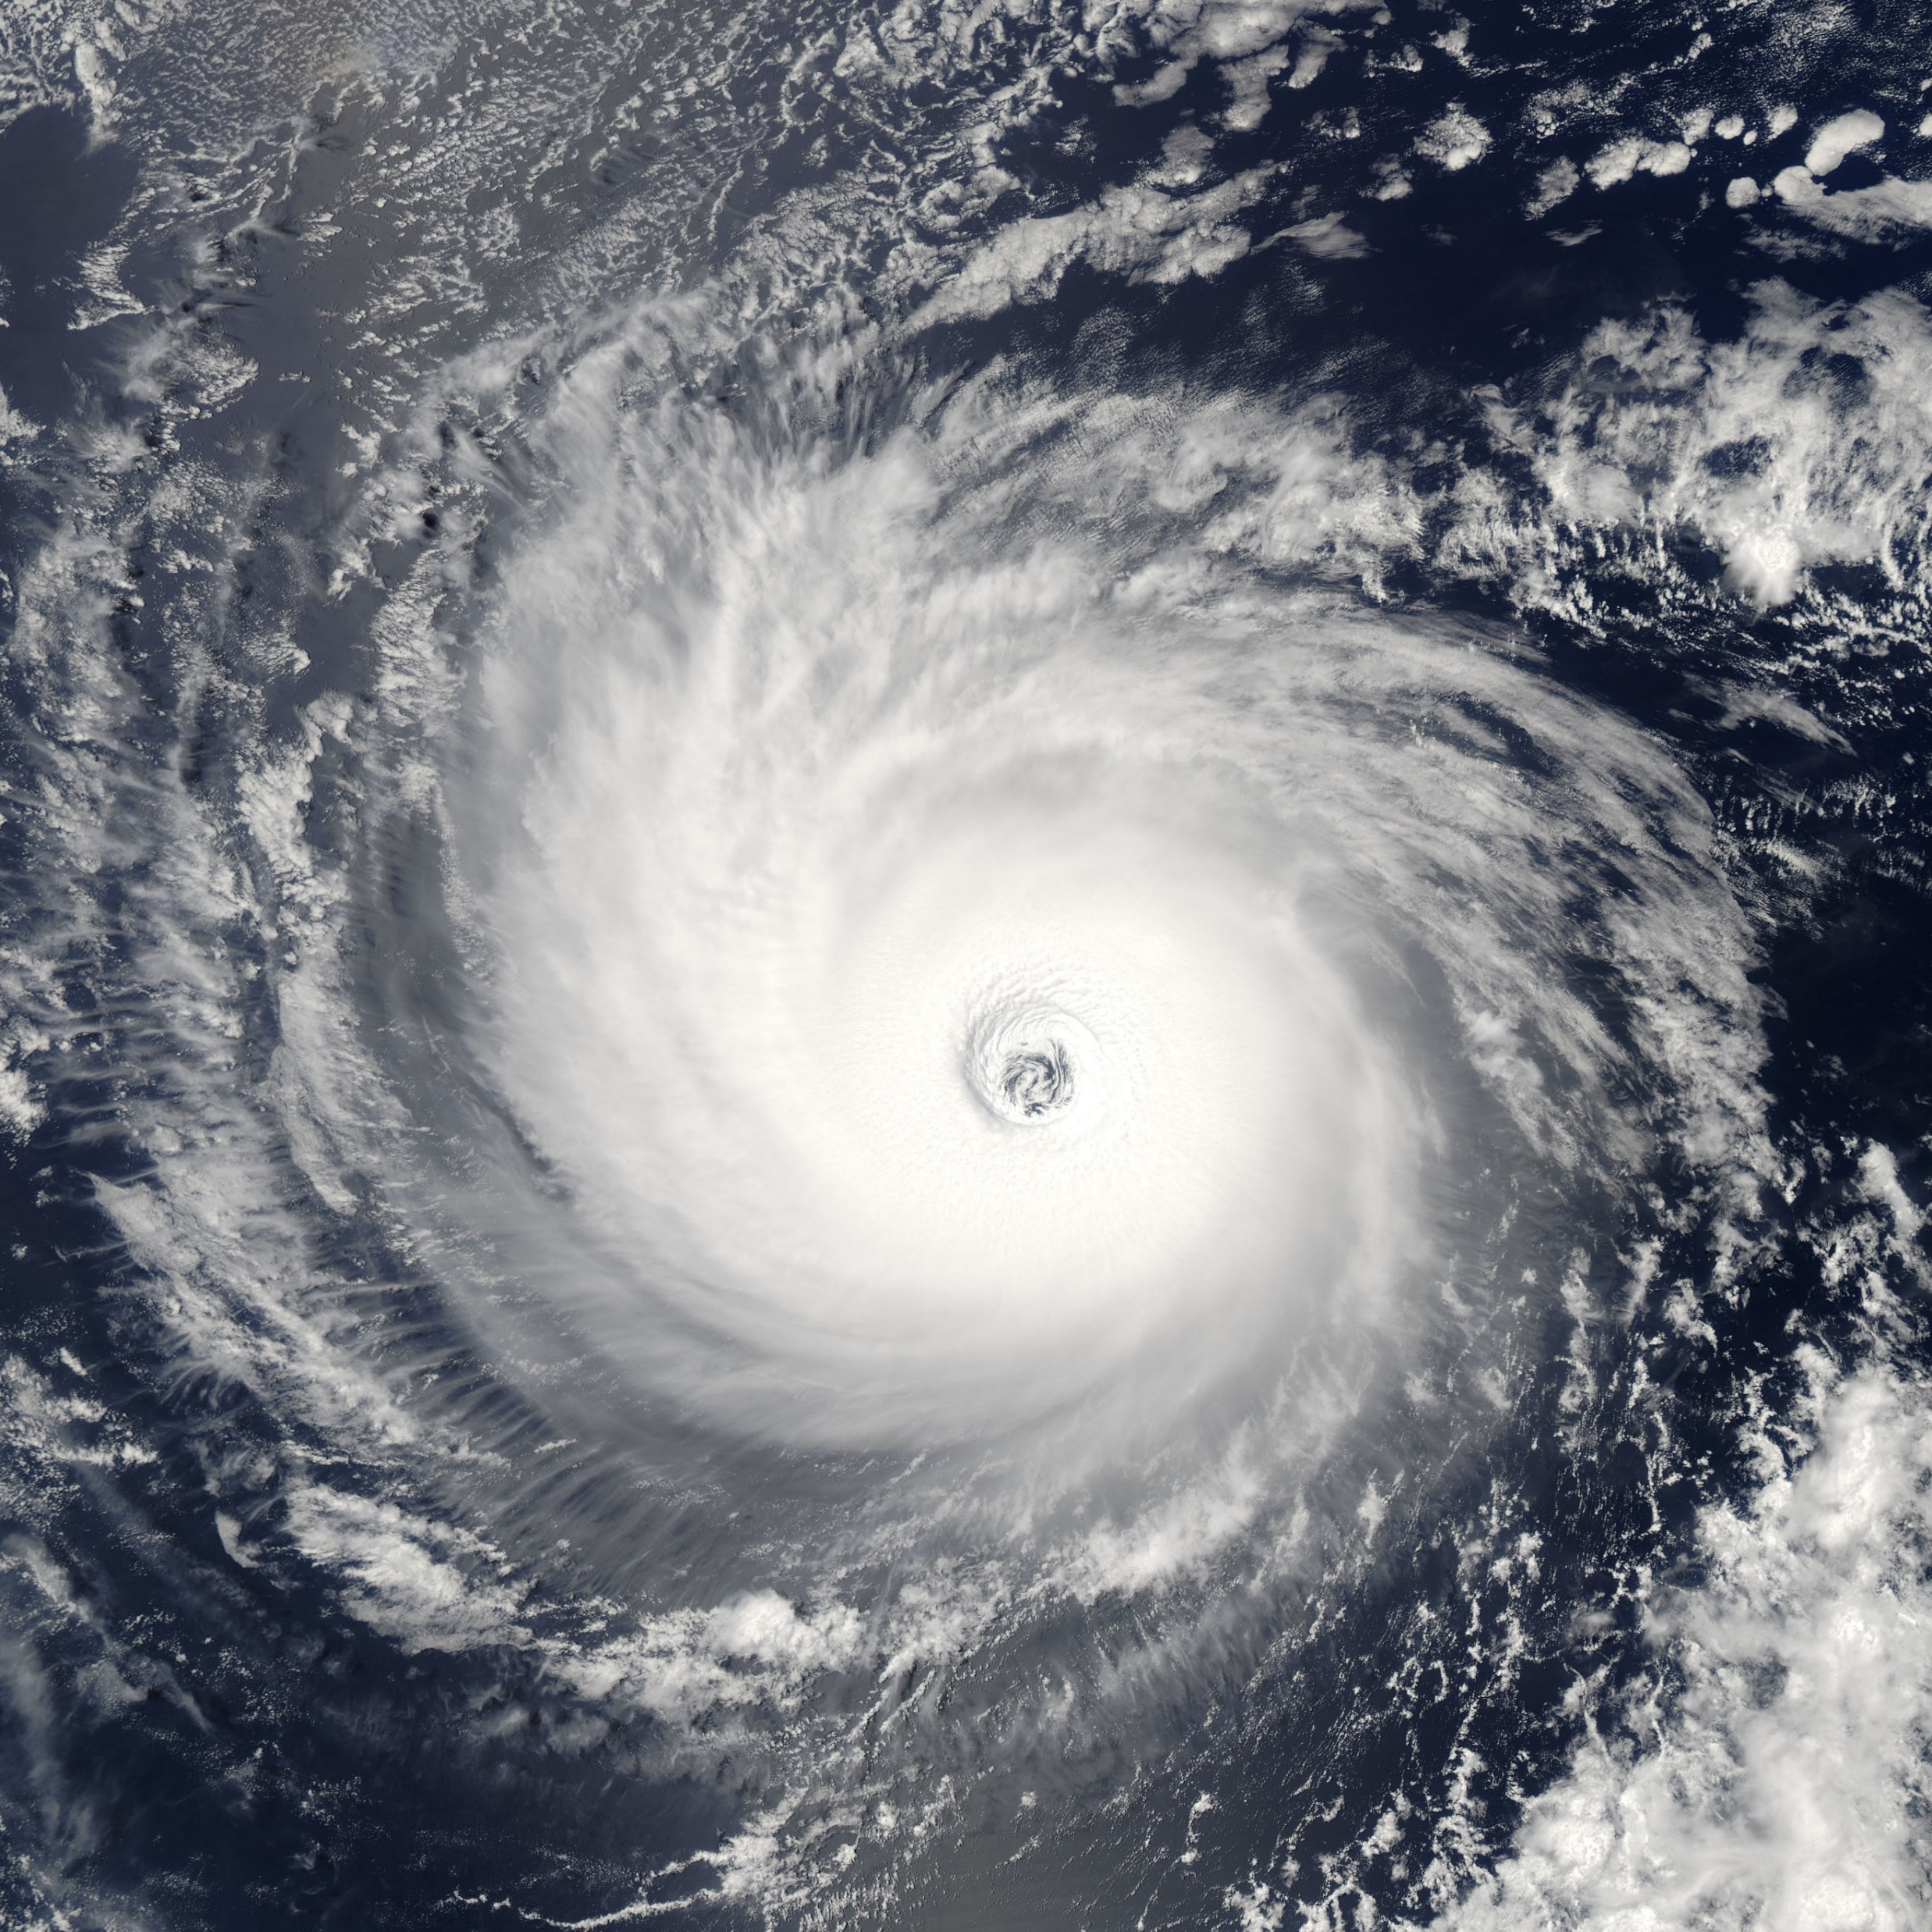
DEFINED CHALLENGES
Shocks are sudden events such as:
Hurricanes & Natural Disasters
Infrastructure Failure/Service Disruptions
Cyberterrorism
Stresses weaken the fabric of a system on a daily or longer term basis:
Aging Infrastructure
Rising Sea Levels
Rising groundwater levels
Salt Water Intrusion
Limited Natural and Financial Resources
Changes in precipitation - increase in Inflow & Infiltration
Population and Development Pressures
Regulatory Requirements
Notes:
Further defined it as it relates to utilities

Slide 5

Defined Qualities of a Resilient Utility Mainstreaming resiliency into planning, design, construction, operations, and policy
Reliable & robust infrastructure
Redundant energy sources
Reduced energy costs
Reduced carbon footprint
Regulatory compliance
Enhances natural systems and public health
Data-driven decision-making
Path to continuous improvement
Notes:
These are the outcomes that we want
Specific examples of the resilience dividend for operationalizing resilience in the utility.
By “Mainstreaming” resiliency into all aspects of planning, design, construction, operations, and policy, utilities can :
Incentivize and evaluate technical innovations
Change the culture of utilities, industry, and community (adopt and adapt)
Empower the workforce to engage in resiliency
Cross-train personnel (engineers in operator spot, operator in engineer spot)
Obtain operator input as it relates to current vulnerability to extreme weather and future resiliency design
Achieve multiple benefits: cost savings of integrating climate adaptation into asset management

Slide 6

Provide Leadership in Measuring & Benchmarking Resilience
Foster Communications & Community Partnership
Foster Collaboration for Integrated Utility Resilience Planning
Vision:
We are
resilient utilities
in a
One Water
coalition
Advance water and energy conservation, alternatives, stewardship, and resource recovery
Build Awareness and Capacity to Operationalize Resilience
Provide an Action-based and High Value Membership Structure
MISSION STATEMENT
By operationalizing resilience through interdisciplinary and integrated planning we are improving water quality, public health, the efficient use of resources, and ensuring responsible investments in our utilities.
6 Organizing Goals

Slide 7
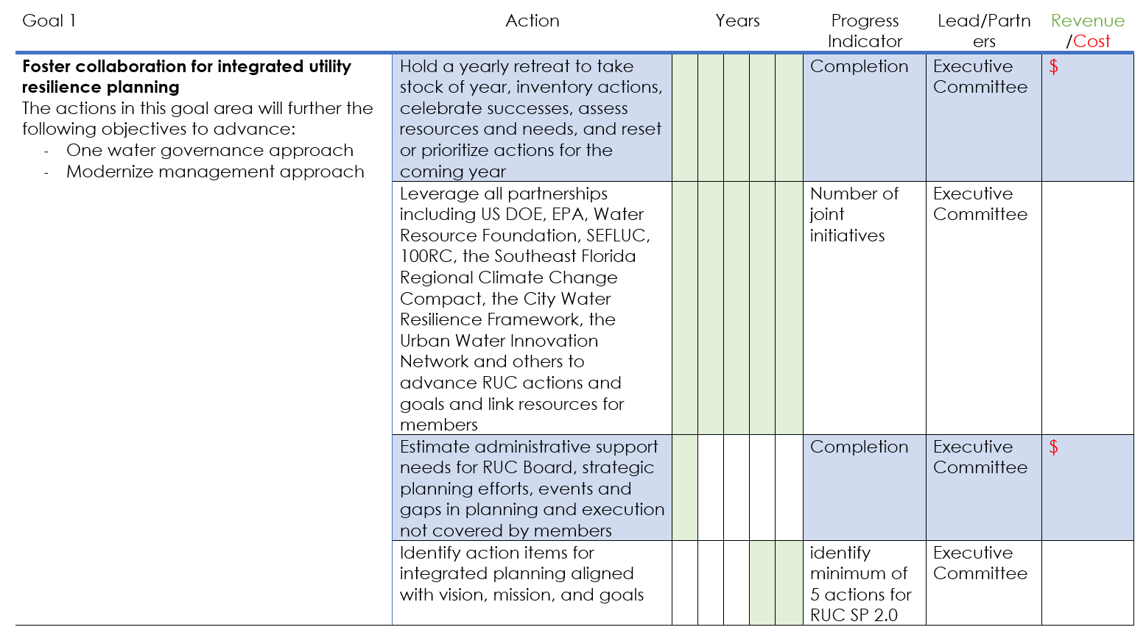

Slide 8
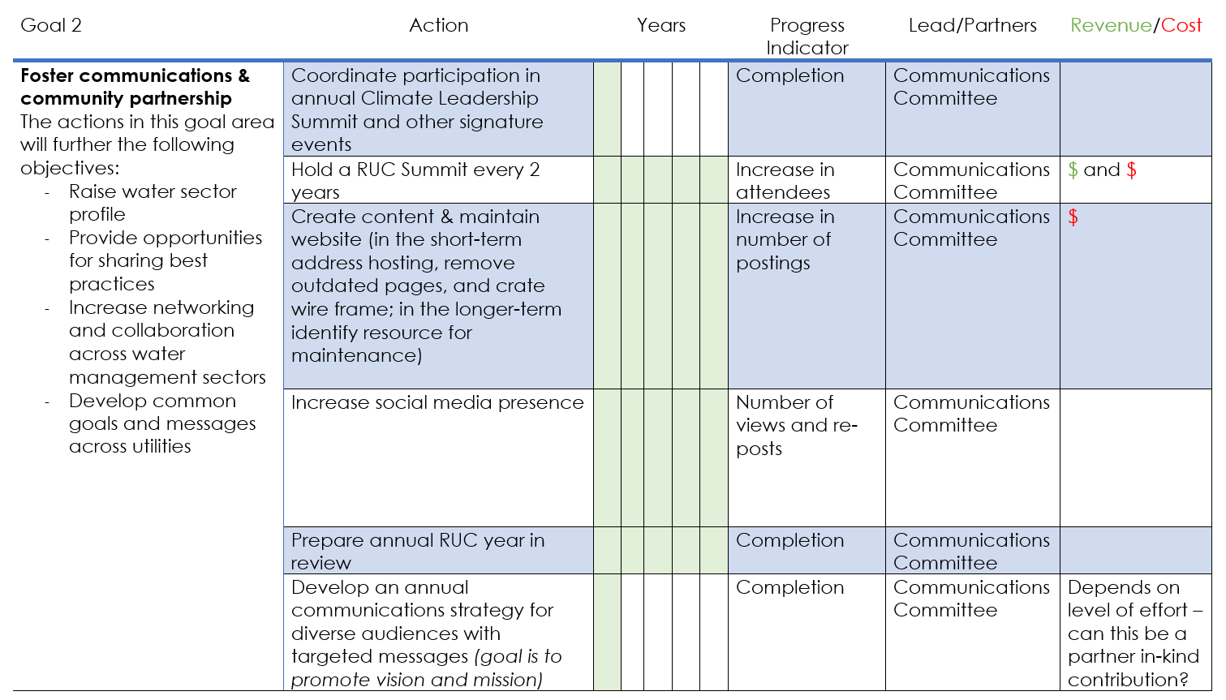

Slide 9
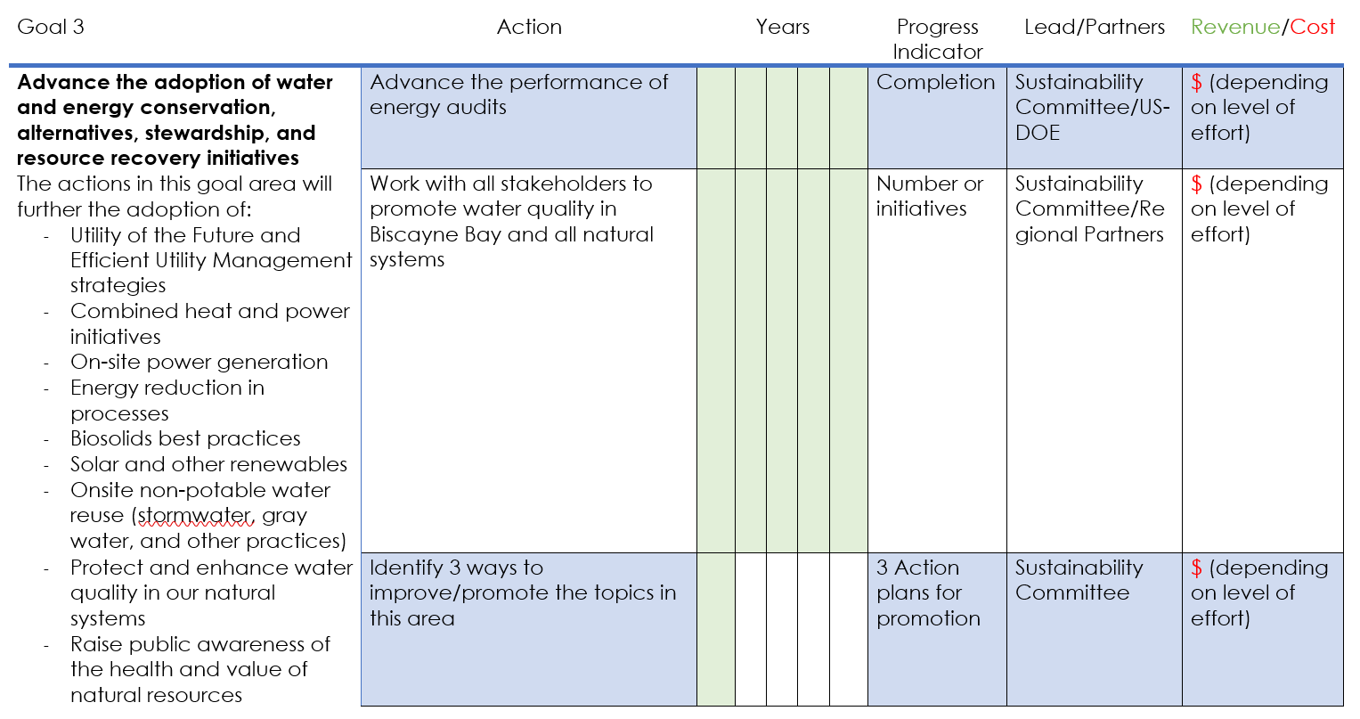

Slide 10
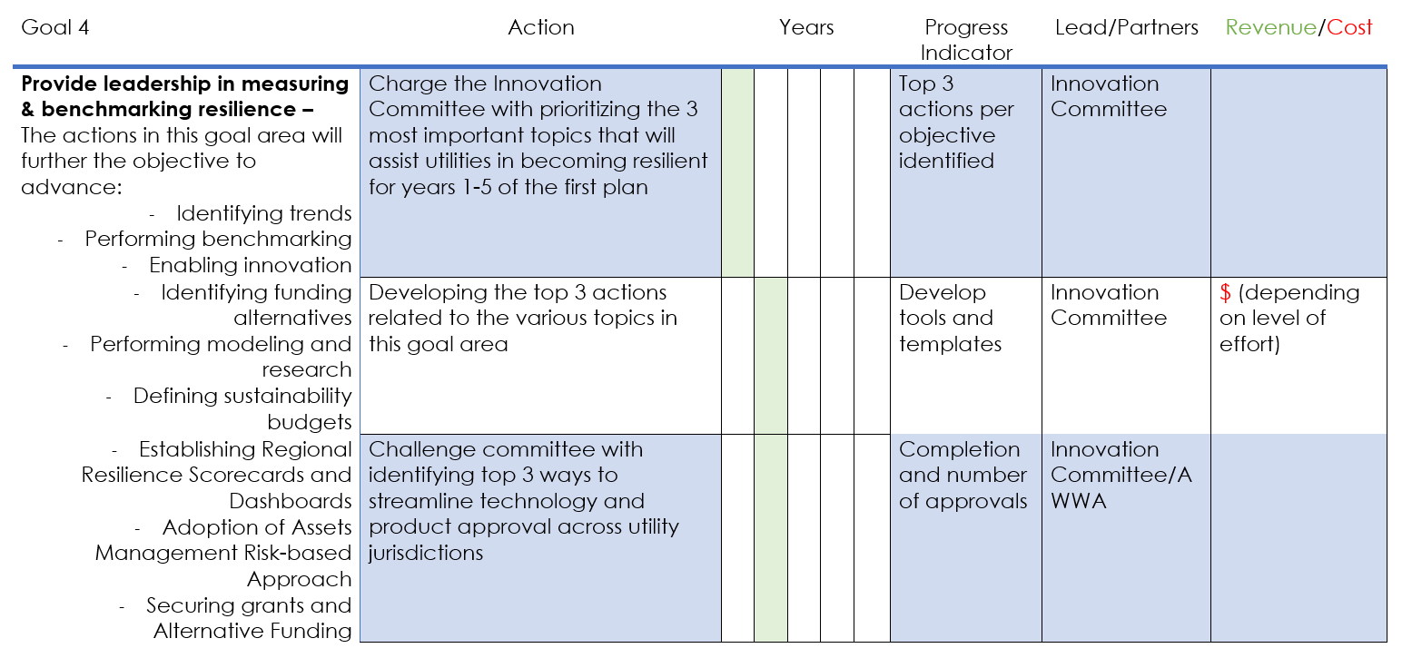

Slide 11
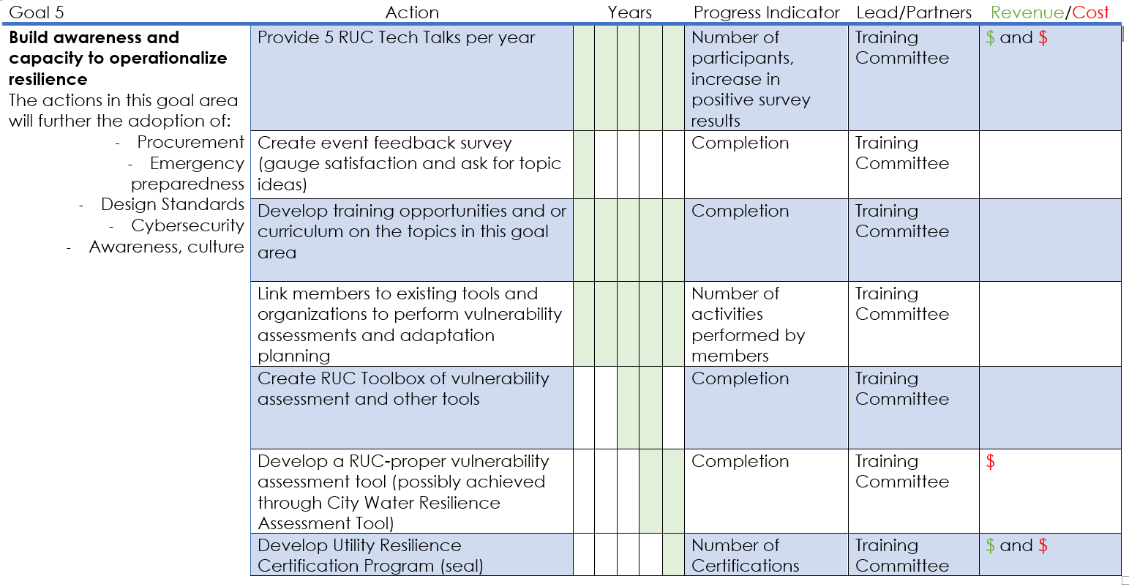

Slide 12
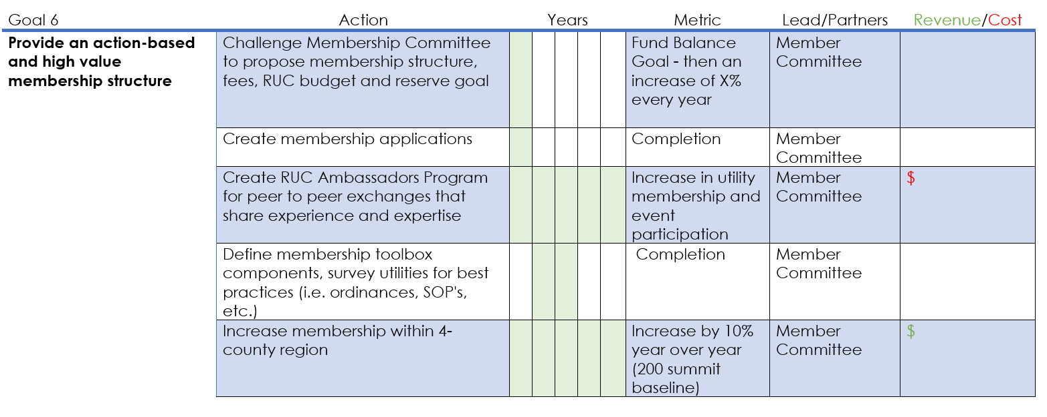

Slide 13

Questions & Feedback

Slide 14
How do we get started? Committees
Executive
Communications
Sustainability
Innovation
Training
Member

Slide 15
Executive/ Nominating Committee Goal 1: Foster collaboration for integrated utility resilience planning and action
Plan and organize annual retreats
Leverage partnership opportunities
Identify resource needs
Lead strategic planning updates
Co-Chairs
Susy Torriente, President
Hardeep Anand, Vice President
Participants
Brenda Rivera
Debbie Griner

Slide 16
Communications Committee Goal 1: Foster communications and community partnerships
Lead planning of RUC Summit (every 2 years) –see comment below
Coordinate participation in annual Climate Leadership Summit and other signature events
Create content & maintain website
Increase social media presence
Prepare annual RUC Year in Review
Develop an annual communications strategy
Share RUC goals and initiatives with partner associations and organizations established in Article 3 of the bylaws to inform their initiatives and legislative priorities
Interface closely with Sustainability Committee regarding messaging on Biscayne Bay
Comments for consideration on call:
Consider sub-groups or leads to focus on specific tasks, i.e. website
Should we consider moving the RUC Summit to Training Committee and changing to Training/Events Committee?
Co-Chairs
Irela Baque
Hardeep Anand
Participants
Kevin Carter
Brenda Rivers (summit planning and preparation)
Others:

Slide 17
Sustainability Committee Goal 3: Advance the adoption of water and energy conservation, alternatives, stewardship, and resource recovery initiatives
Work with all stakeholders to promote water quality in Biscayne Bay and all natural systems (coordinate closely with Communications Committee)
Advance performance of energy audits
Identify 3 ways to improve/promote the topics in this area:
Co-Chairs
Debbie Griner
Rafael Frias
Participants
Alice Dasek
Tiffany Troxler (also Chairing Innovations Cte. so participation will be focused on specific tasks that benefit from academia perspective/resources)
Juan Aceituno
Others:
Utility of the Future and Efficient Utility Management strategies
Protect and enhance water quality in our natural systems
Raise public awareness of the health and value of natural resources
Combined heat and power
On-site power generation
Energy reduction in processes
Biosolids best practices
Solar and other renewables
Water conservation
Onsite non-potable water reuse

Slide 18
Innovation Committee Goal 4: Provide leadership in measuring and benchmarking resilience
Prioritize the 3 most important topics in the area of innovation that will assist utilities in becoming resilient for years 1-5 of the first
(Year 2) Developing the top 3 actions for the 3 topics
(Year 2) Challenge committee with identifying top 3 ways to streamline technology and product approval across utility jurisdictions
Co-Chairs
Carolina Maran
Tiffany Troxler
Participants

Slide 19
Training Committee Goal 5: Build awareness and capacity to operationalize resilience
Organize 5 RUC Tech Talks per year
Create event feedback survey
Develop training opportunities and or curriculum on the topics in this goal area:
Procurement
Emergency preparedness
Design Standards
Cybersecurity
Awareness, culture
Link members to existing tools and organizations to perform vulnerability assessments and adaptation planning
Coordinate closely with Sustainability and Innovation Cte’s on their top 3 topics
Comments for consideration on call:
Should we consider moving the RUC Summit to this committee and changing it to Training/Events Committee?
Co-Chairs
Andres Gomez
Josenrique Cueto
Participants
Tiffany Troxler
Carolina Maran
Others:

Slide 20
Member Committee Goal 6: Provide an action-based and high value membership structure
File Articles of Incorporation as a Florida Non-Profit
Propose membership structure, fees, RUC budget and reserve goal
Create membership applications
Manage coalition finances
Create RUC Ambassadors Program for peer to peer exchanges that share experience and expertise
Co-Chairs
Austin P’Pool (suggested)
Juan Oquendo (suggested)
Participants
Brenda Rivera
Student participation (FIU)
Others:

Slide 21

Thank you for you continued commitment and support.
Together our contributions guarantee RUC’s continued success!

